Slide 1
Hypothesis testing

Slide 2
Hypothesis testing
Hypothesis testing is the procedure in which data from a sample are used to evaluate a hypothesis about a population.
For example, Pema has a boyfriend, named Dorji and she believes (hypothesizes) that Dorji loves her, then he should spent time with her, do nice things for her and so on. If Dorji does these things, then there is no reason to for Pema to question his love for her. But if Dorji does not do these things-if the observed behavior doesn’t match the expected behavior-then she’ll to start wondering if he truly loves her.
(Remember: the love example shows how humans use hypothesis testing intuitively)

Slide 3
The process of hypothesis testing
A hypothesis testing is about a population but not about a sample. This is because a researcher wants to make conclusion about a population and not a sample.
There should be two hypothesis: Null and Alternative hypothesis and the two hypothesis must be all-inclusive (they should cover all possible outcomes and must be mutually exclusive (only one hypothesis at one time can be true).
The null hypothesis is a negative statement and makes a specific prediction.
The alternative hypothesis is what the researcher believes is true, is not a specific prediction.
A negative statement cant be proven true BUT can be disproven.
If the null hypothesis is rejected then researcher has to accept the mutually exclusive alternative hypothesis.
If a researcher fails to disprove the null hypothesis then the researcher states that enough evidence is not found to reject the null hypothesis.

Slide 4
Six steps of hypothesis testing
Pick the statistical Tests.
Check the Assumptions to make sure if it is correct to do the test.
List the null and alternative Hypothesis.
Determine when to reject the null hypothesis (set the critical values).
Calculate the value of the test statistic.
Interpret what the result(s) mean.

Slide 5
Example 1
For example, Tenzin, wonders whether student coming from eastern Bhutan differ in intelligence than the students from other regions. To assess this Tenzin obtains a random sample of 62 students from the population and gives each of them a test. He finds that the mean IQ of these 62 students are 105. The average IQ of students recorded (found in literature) in Bhutan is 100 with a standard deviation of 10. Can he conclude that the students coming from the eastern Bhutan differ in intelligence than the students from other regions?

Slide 6
1. Pick the (right) statistical Tests.
Choosing correct test depends on a variety of factors such as the question being asked, the type of study being done, and the level of measurement of the data
z test can be performed to answer whether the students coming from eastern Bhutan differ in intelligence from the general population. z test can be used because population standard deviation is known (σ = 10).

Slide 7
2. Check the Assumptions to make sure if it is correct to do the test.
There are three assumptions: (a) Random sample, (b) Independence and (c) Normality. Before proceeding make sure that assumptions are met.
For example, athletes are tested for for-performance enhancing substance. The tests depends on many assumptions. For the tests to be meaningful: it is assumed that the tests being performed is the athlete’s; that the sample was stored at the right temperature after it has taken and the machine used to test it is correctly calibrated.

Slide 8
2. Check the Assumptions (contd….)
Random sample: not violated.
Independence: the scores of IQ are not influenced by other cases: not violated.
Normality: the psychological variables is assumed to be normally distributed: not violated.
 | Assumptions | Explanation for assumptions
1 | Random samples | Sample is a random sample from a population
2 | Independence of observations | The cases in the sample are independent of each other and is not influenced by any other cases in any circumstance.
3 | Normality | The dependent variable is normally distributed in the population.

Slide 9
3. List the null and alternative Hypothesis
Listing the hypothesis and deciding whether they are two tailed (non – directional and it can be less than -1.96σ from the mean (0) or it can be more than 1.96σ above the mean (0)) or one tailed (directional either less than -1.96σ or more than 1.96σ) which fall in the alpha (α) region of normal curve.
Specify one tailed or two tailed: The research question is whether the intelligence (IQ) of students coming from eastern Bhutan is different. It doesn’t specify whether less or more so it is a two tailed test.
First generate null hypothesis and then alternative hypothesis.
Null hypothesis (a) must be about the population, (b) a negative statement and (c) a specific statement. All of these conditions can be met by: Hо: µ of students from east = 100 or Hо: µ = 100

Slide 10
3. List the null and alternative Hypothesis (contd…)
Hо: µ = 100; (check whether the assumptions of null hypothesis are met)
µ is about the population.
It’s a negative statement as it says “[Hо: µ = 100 ]; the IQ of students from eastern Bhutan is NOT different from the IQ of Bhutenese population”.
It is specific because it says, the population mean (µ) is exactly 100.
Alternative hypothesis: the alternative hypothesis must be mutually exclusive to the null hypothesis and the two hypothesis must be all inclusive. The alternative hypothesis must not make a specific prediction and it just states that null hypothesis is wrong. Therefore, the alternative hypothesis (Ha) says that the population mean (µ) for students from east Bhutan is something other than 100; Ha: µ ≠ 100.

Slide 11
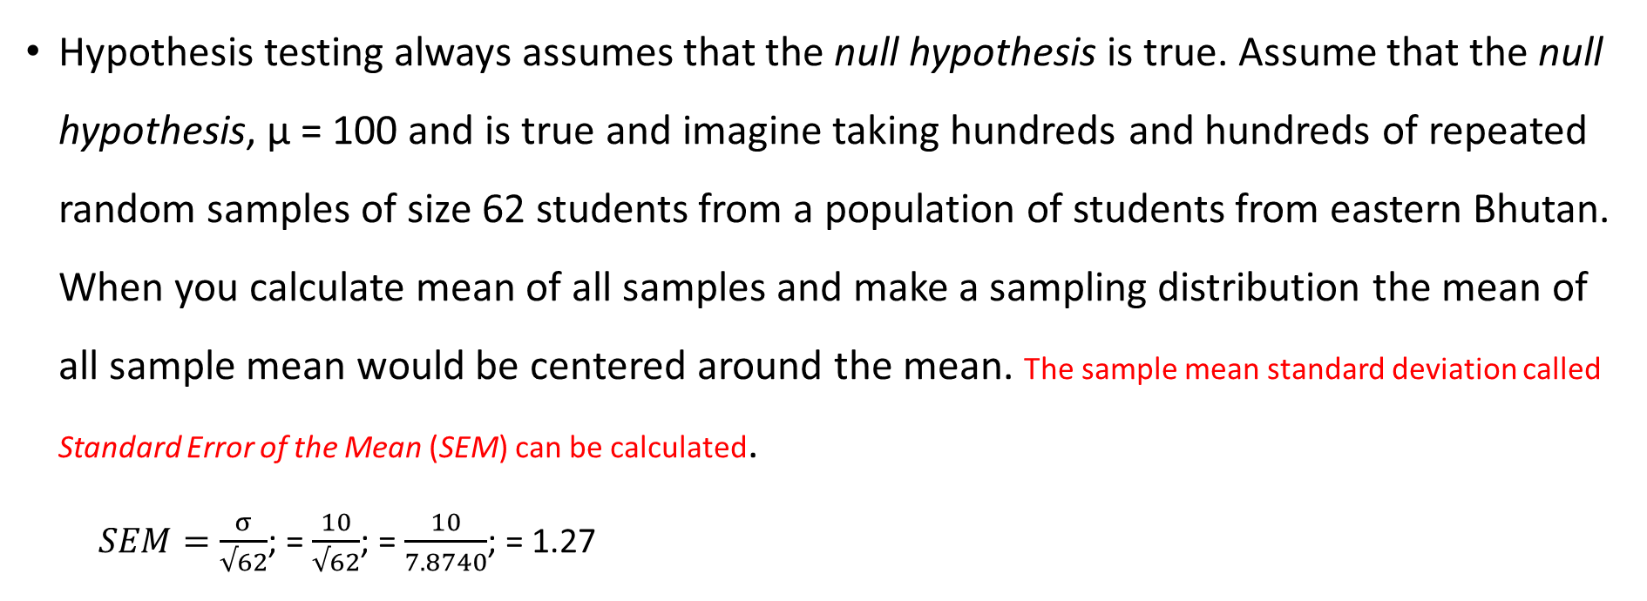
4. Determine when to reject the null hypothesis (set the critical values or decision rule)
Hypothesis testing always assumes that the null hypothesis is true. Assume that the null hypothesis, µ = 100 and is true and imagine taking hundreds and hundreds of repeated random samples of size 62 students from a population of students from eastern Bhutan. When you calculate mean of all samples and make a sampling distribution the mean of all sample mean would be centered around the mean. The sample mean standard deviation called Standard Error of the Mean (SEM) can be calculated.
$SEM=\frac{σ}{√62}$; = $\frac{10}{√62}$; = $\frac{10}{7.8740}$; = 1.27
Mr. Tenzin wants to keep the confidence level as 95% which means he is setting +1.96 and -1.96 z score in the normal curve to make a decision. The confidence Interval can be calculated as (CI) = mean (µ) ± 1.96σ(SEM)

Slide 12
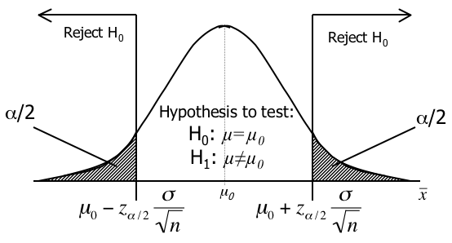
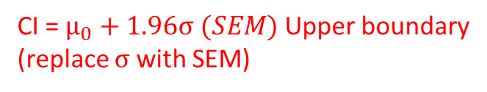


Two tailed test with rejection region in both tails
The rejection region is split equally between the two tails.
CI = $µ_{0}+1.96σ (SEM)$ Upper boundary
(replace $σ$ with SEM)
CI = $µ_{0}−1.96σ (SEM)$ Lower boundary
Analysis: Sample mean is 105 which is outside of critical value (102.49). So it is outside the 95% confidence level
CI = 100$+1.96σ (1.27)$ = 102.49 (Upper boundary)
CI = 100$−1.96σ (1.27)$ = 97.51 (Lower boundary)

Slide 13
5. Calculate the value of the test statistic
The critical value set is -1.96 and +1.96. If the computed z score falls in the rare zone then the null hypothesis is rejected. So mathematically, it can be written as : if z ≤ -1.96 or z ≥ +1.96 then reject Hо and if the computed z score is greater than -1.96 or less than +1.96, then the researcher fail to reject the null hypothesis.
Calculate the test statistics: $z=\frac{X−µ}{SEM};=\frac{105−100}{1.27}$; $=\frac{5}{1.27};=3.95$
6. Interpret what the result(s) mean
Is the value of 3.95 greater than +1.96?
Is the value of 3.95 smaller than -1.96?
The first statement is TRUE. This means that result fall in the rare zone and the null hypothesis is rejected.

Slide 14
Example 1
A company has been selling bottled water to CNR for a long time. Each bottle is labelled as water containing 355 ml of water. One day one of the students thinks that there is actually less water than what is shown in the label. So all the students starts asking “Is there, on average, at least 355 ml of water in each bottle?”
Quantity of water ≥ 355 ml of water.
Why customers say ‘at least’ because customers are paying for it?
Manufacturer: “Is there, on average, exactly = 355 ml of water in each bottle?”
Quantity of water = 355 ml of water

Slide 15
Example 2
Company claim: The new car engine manufacture has high fuel efficiency which means it can give more mileage than others for which current engine gives 30 miles per litre.
Fuel efficiency ˃ 30 mpl
The manufacturer is making a claim which it wishes to test. It is not testing an assumption that already exist.
Example 1 is an assumption (which is labelled and assuming based on the position of people with reference to the product while Example 2 is about claim which is about the unknown. This is because how much fuel will be consumed by the new car engine is not known and it only says that it is fuel efficient.

Slide 16

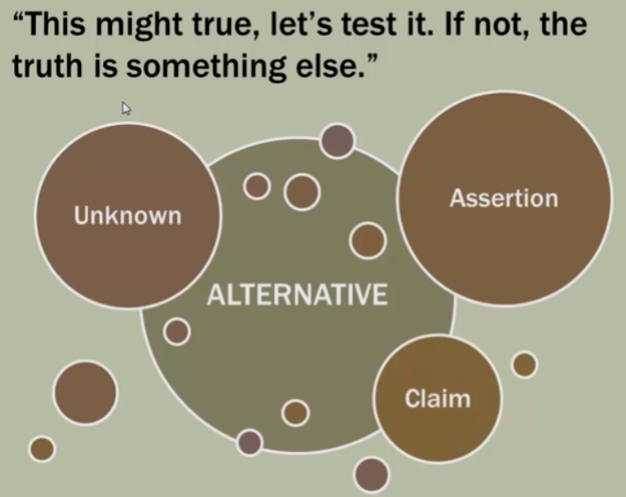
Note: ask these two questions while testing hypothesis
Am I testing an assumption (status quo) that already exist (water bottle case) or am I testing a claim or assertion beyond what I already know or can know (hybrid engine case)?
But if you want to test the mileage what is already listed on the car document then it becomes an assumption but not a claim.

Slide 17
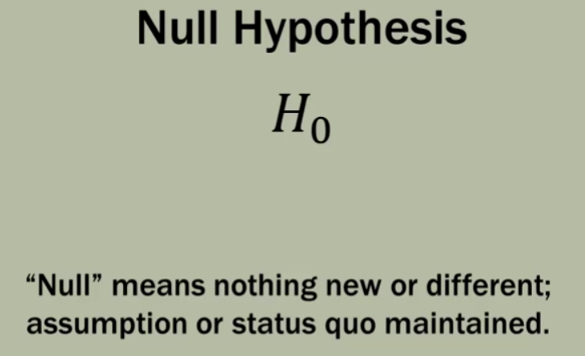
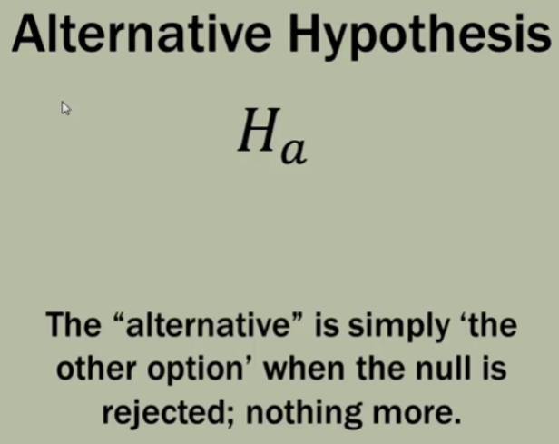
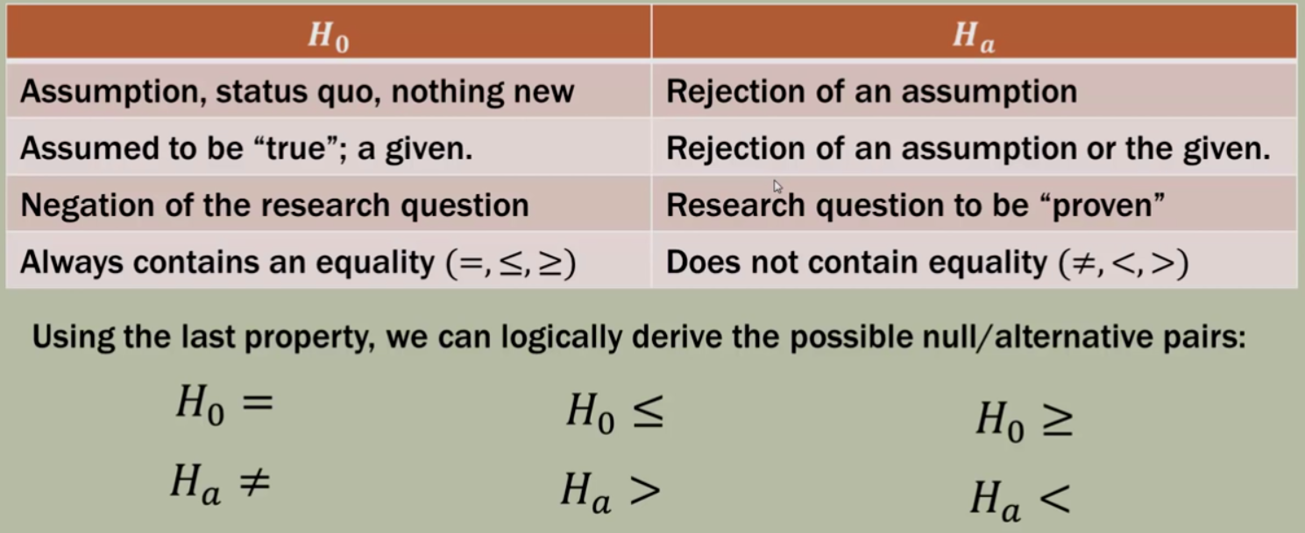

Slide 18
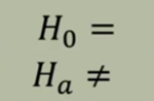
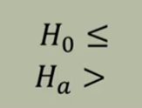
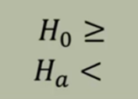
Example 1 contd….
A bottled water manufacturer states on the product label that each bottle contains 355 ml of water. You work for a government agency that protects consumers by testing product volumes. A sample of 50 bottle is tested.
Guess!!! What would be your assumption?
Ans: the 355 ml on the bottle is assumed to be true.
Which hypothesis pair seems to be appropriate?

Slide 19
Contd….
if the data indicates that the bottles are being filled properly, then we fail to reject the null hypothesis (fail to reject our assumption).
What is our assumption?: The water contained in each bottle = 355 ml. [Hо = 355 ml; Hα ≠ 355 ml].

Slide 20
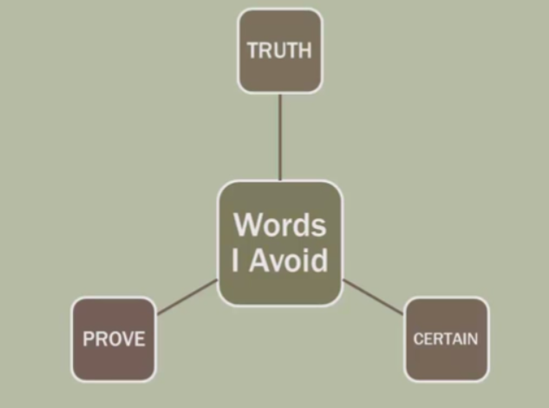
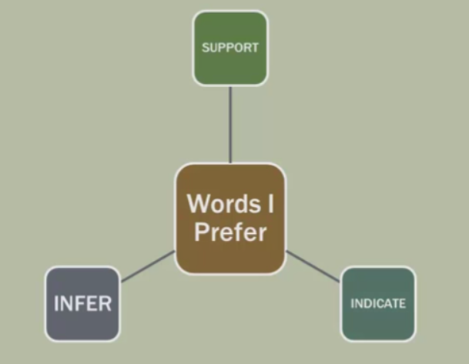
Note: words to avoid and use

Slide 21
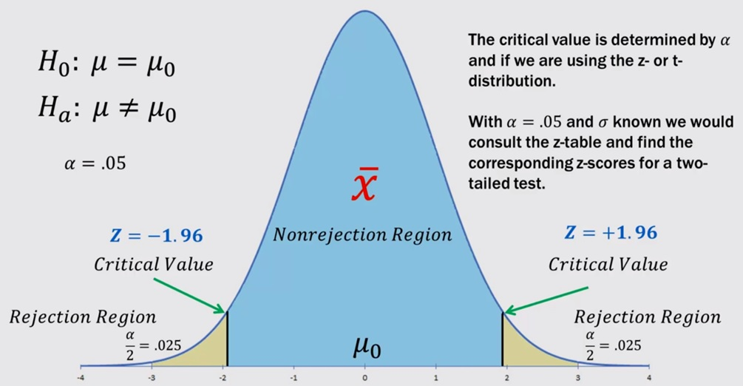
Two tailed z-test rejection region

Slide 22
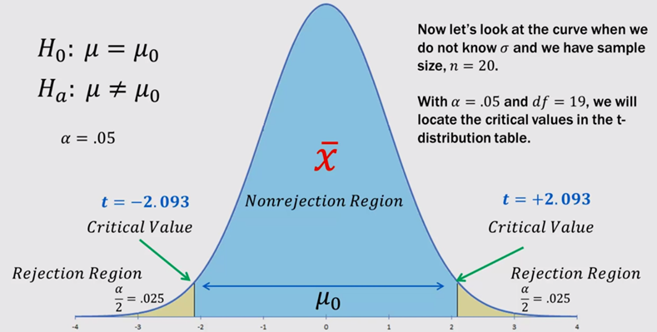
Two t-test rejection region

Slide 23
Reference
Field, A. (2009). Discovering Statistics using SPSS. Sage publication.
Bryman, A. (2008). Social Research Methods. Oxford University Press.

